Slide 1
Capstone Project Food Forecasting Analysis
Submitted By Date of Submission
Mamta Urade 22 Sep 2021

Slide 2
Here's the Problem Statement:
Your client is a meal delivery company that operates in multiple cities. They have various fulfillment centers in these cities for dispatching meal orders to their customers. The client wants to help these centers with demand forecasting for upcoming weeks so that these centers will plan the stock of raw materials accordingly.
The replenishment of the majority of raw materials is done on a weekly basis and since the raw material is perishable, procurement planning is of utmost importance. Secondly, staffing of the centers is also one area wherein accurate demand forecasts are really helpful. We have the below information with us in the form of 3 different datasets:
Historical data of demand for a product-center combination
Product (Meal) features such as category, sub-category, current price and discount
Information for fulfillment centers like center area, city information, etc.
You need to come up with a story in Tableau that talks about the level of demand in each center. This analysis needs to be granular enough to include product information as well. The client wants an end-to-end report to understand which fulfillment areas are doing well and which aren't. You can also talk about center-meal combinations to add nuance to your final submission.

Slide 3
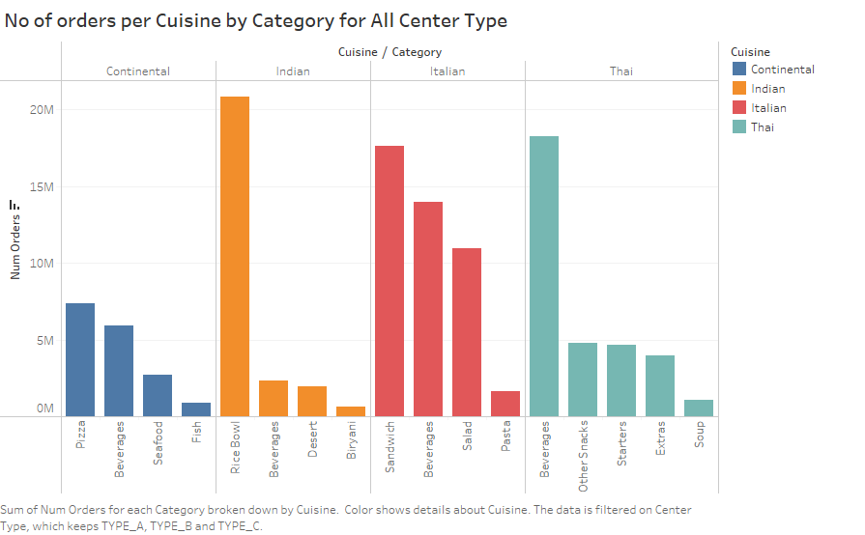
Some Charts

Slide 4
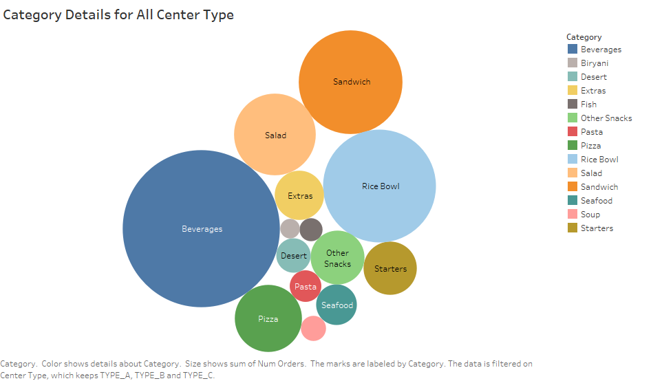

Slide 5
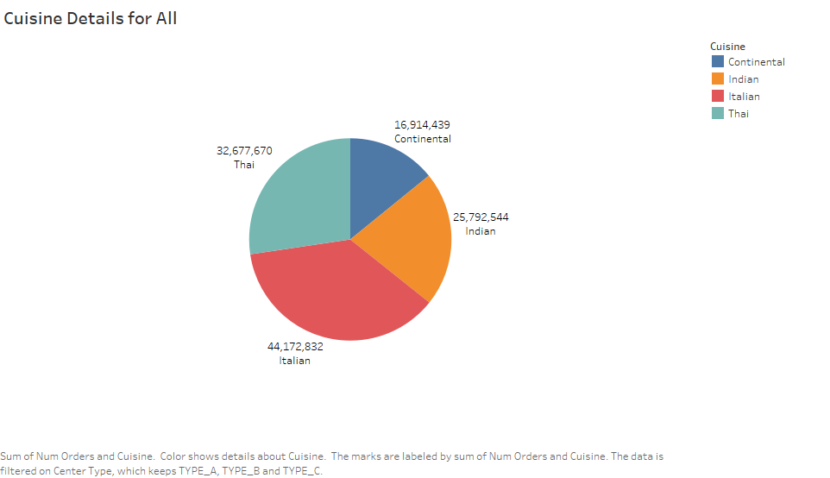

Slide 6
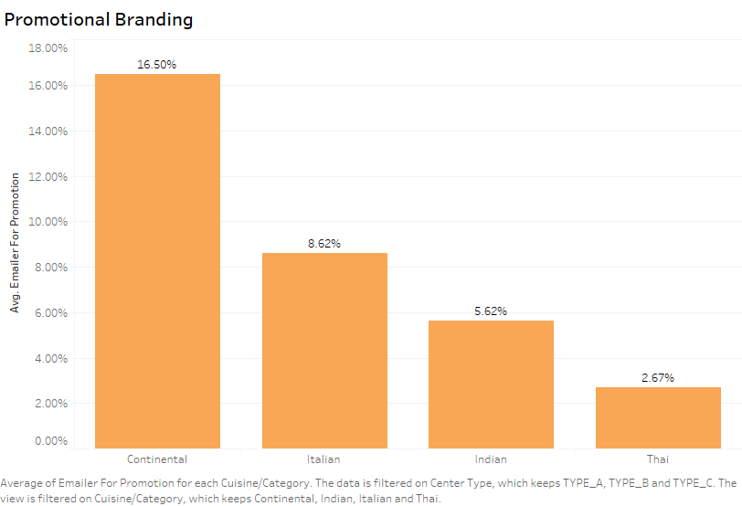
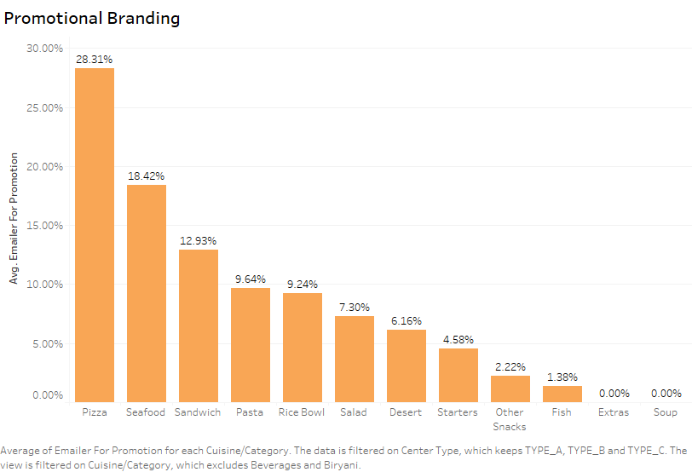

Slide 7
Dashboards

Slide 8
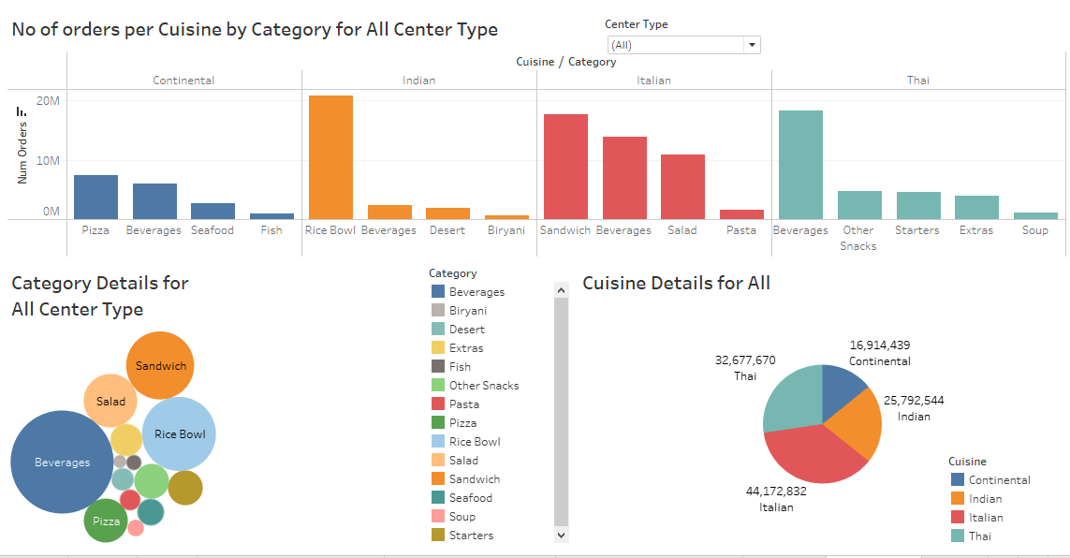

Slide 9
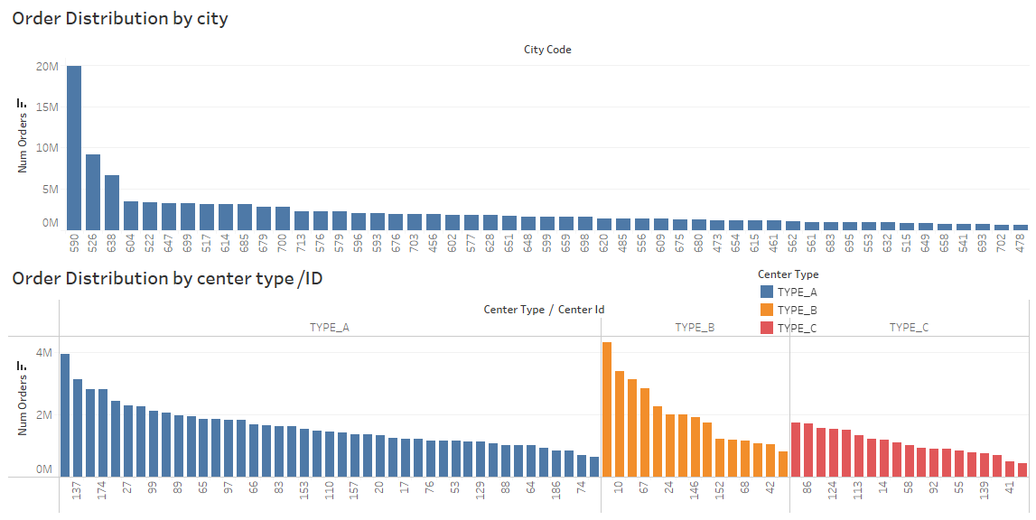

Slide 10
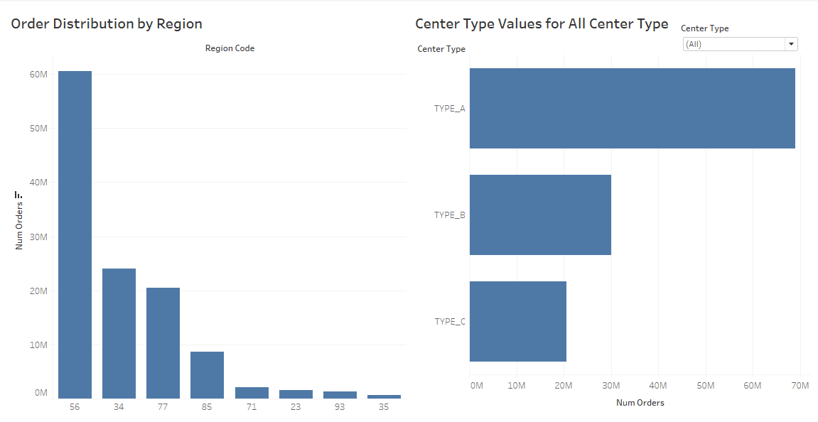

Slide 11
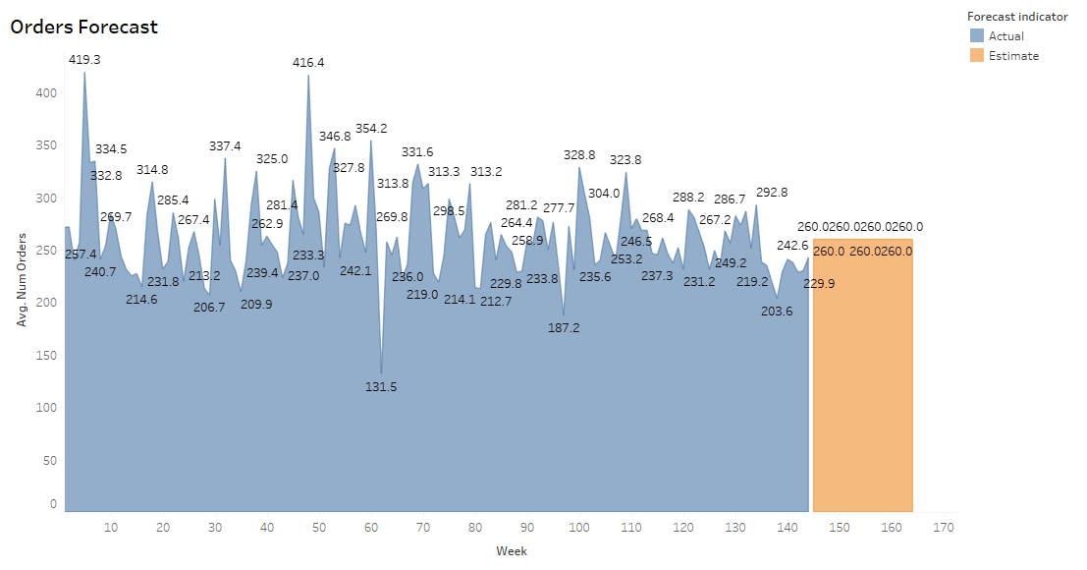

Slide 12
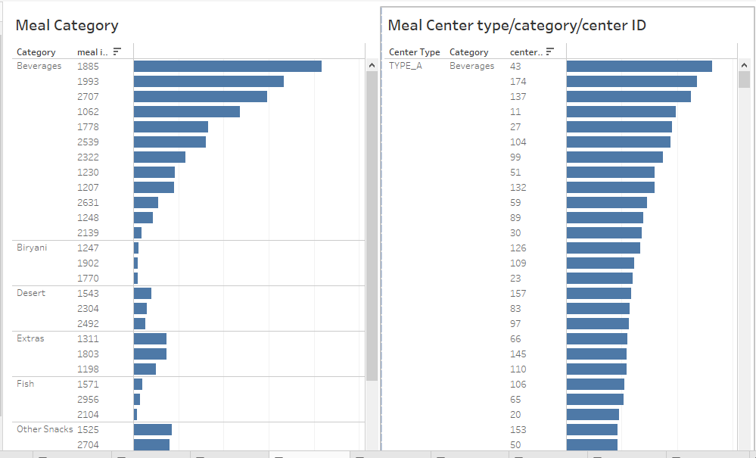

Slide 13
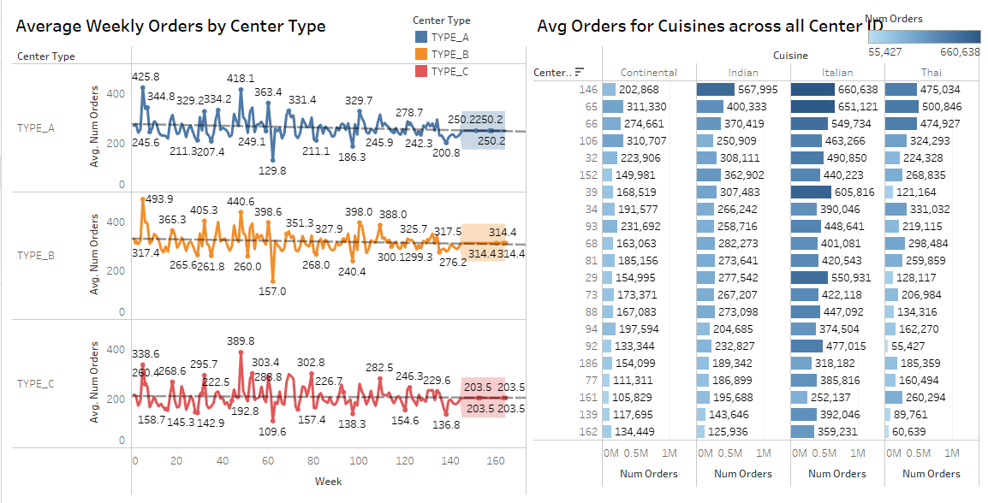

Slide 14
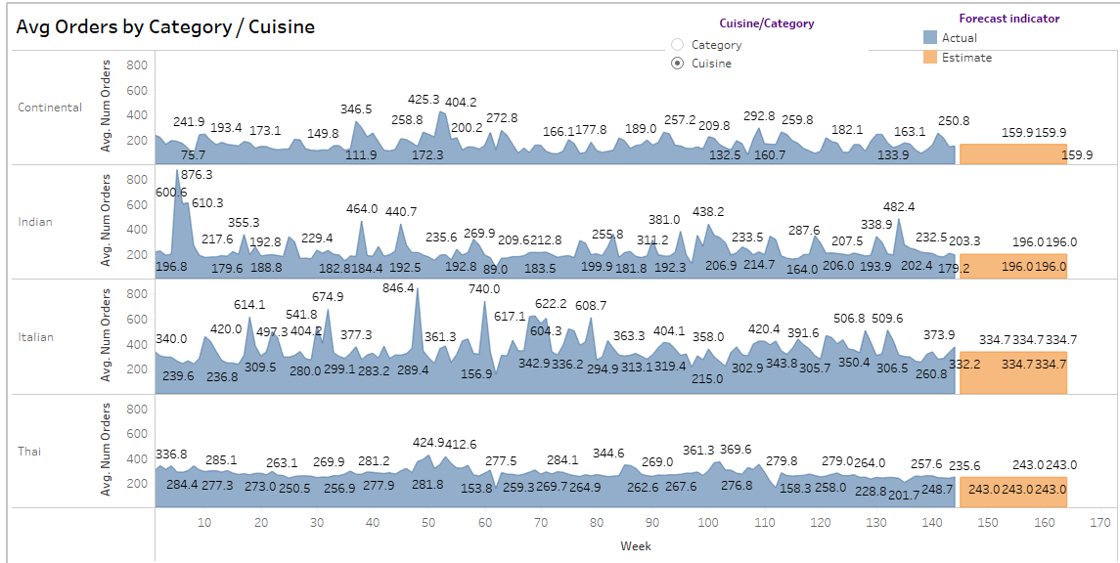

Slide 15
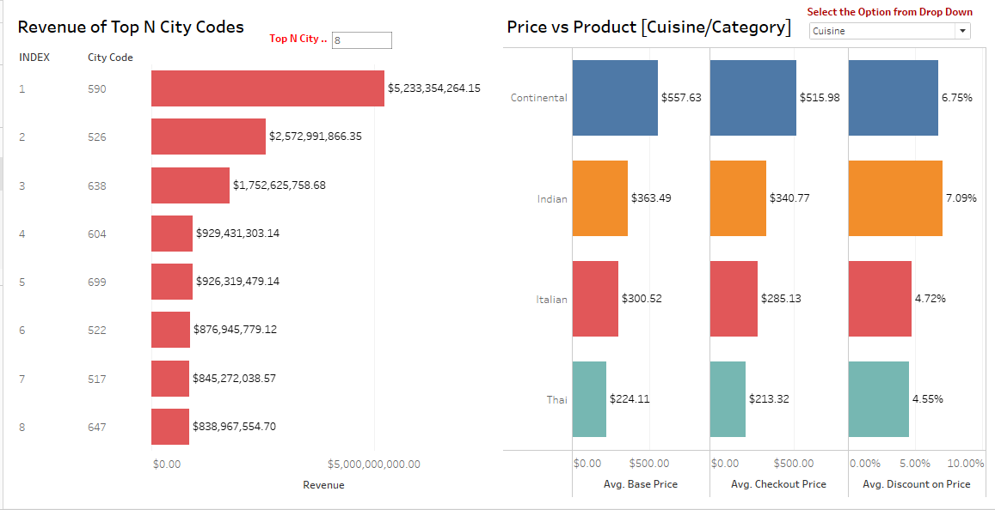

Slide 16
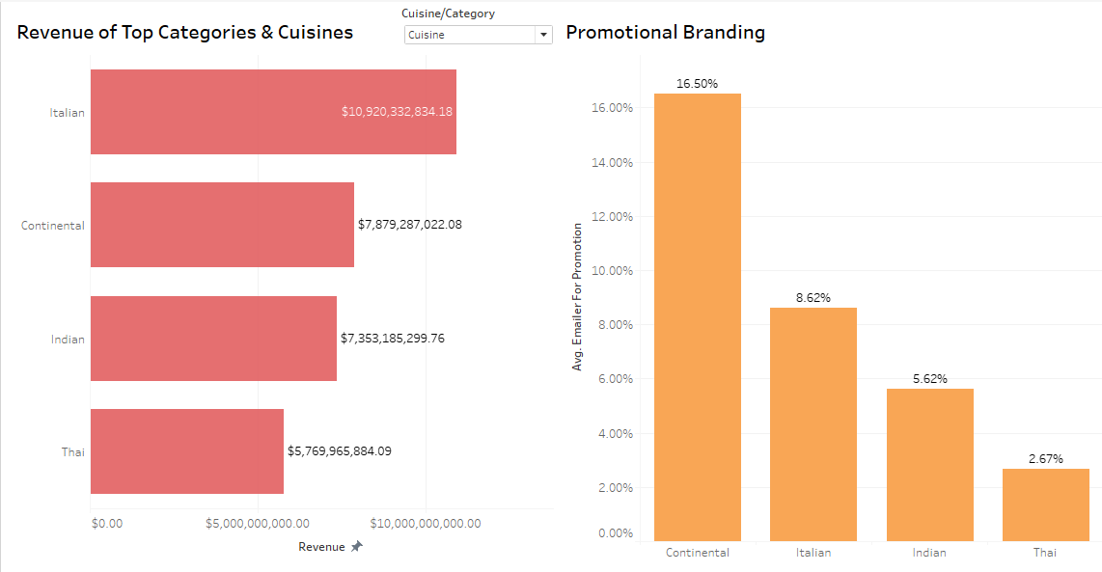

Slide 17
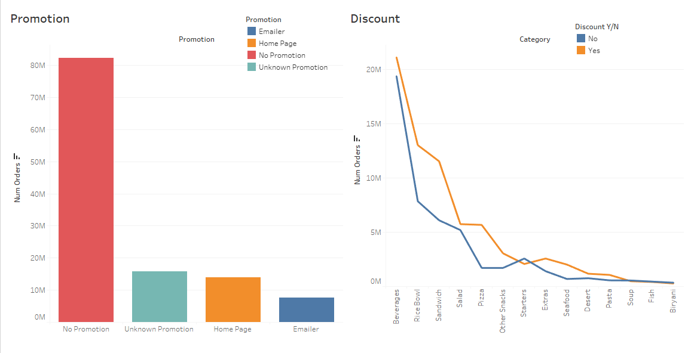

Slide 18
Storyboards

Slide 19
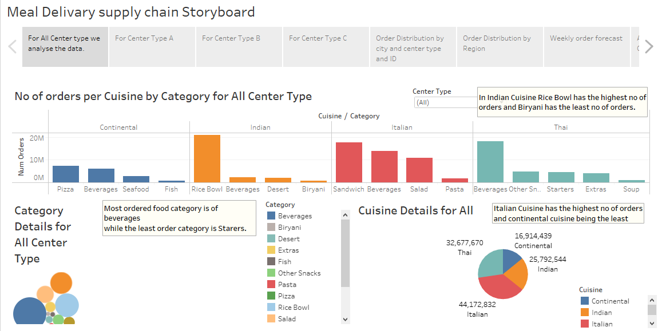

Slide 20
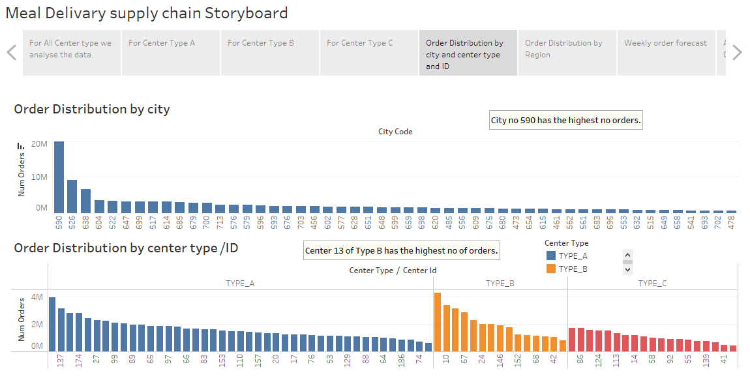

Slide 21
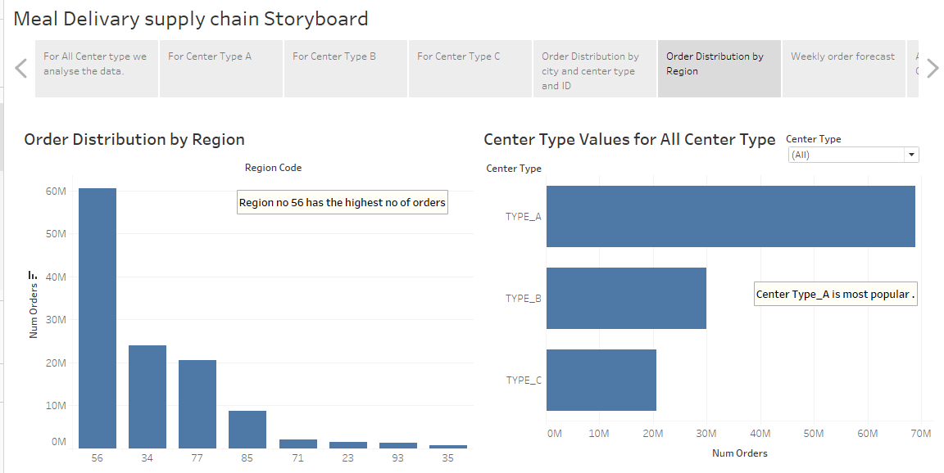

Slide 22
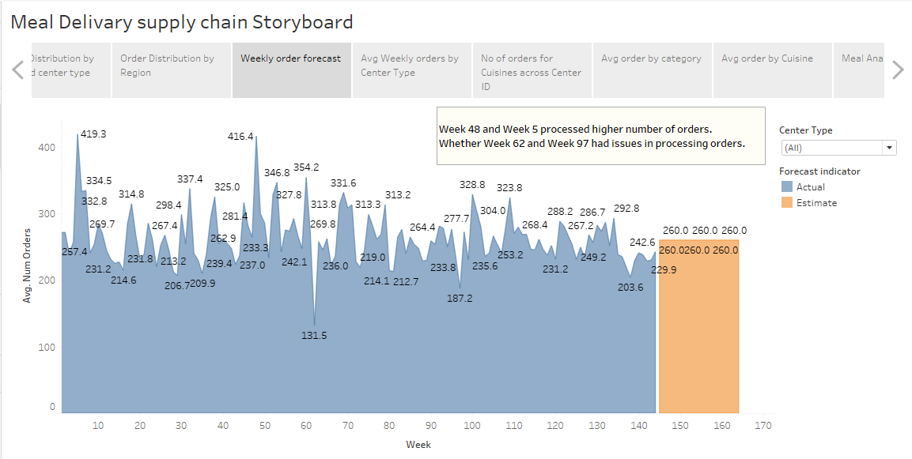

Slide 23
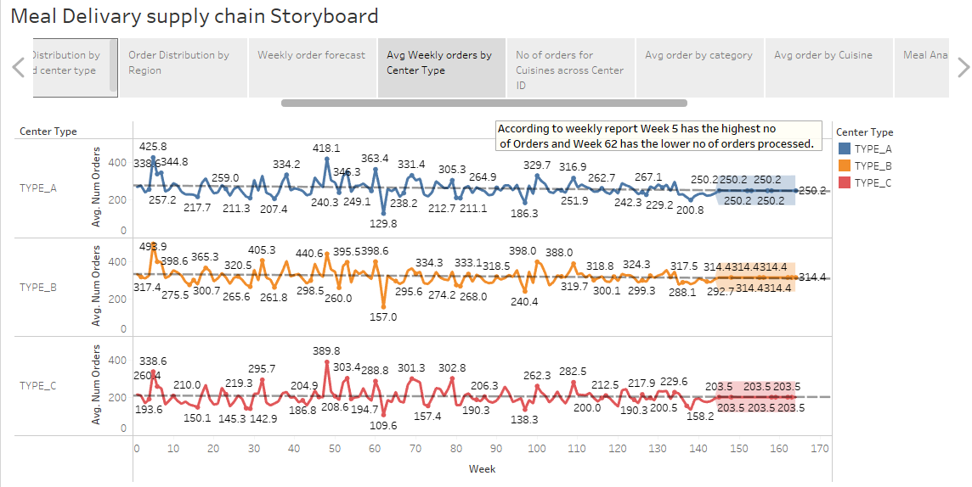

Slide 24
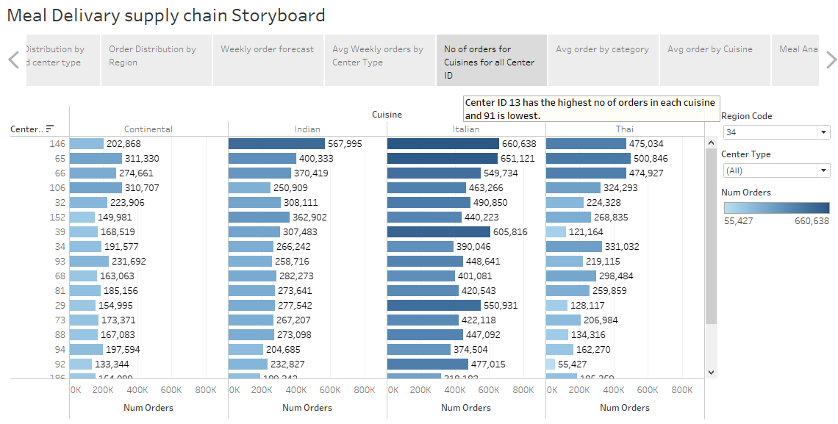

Slide 25
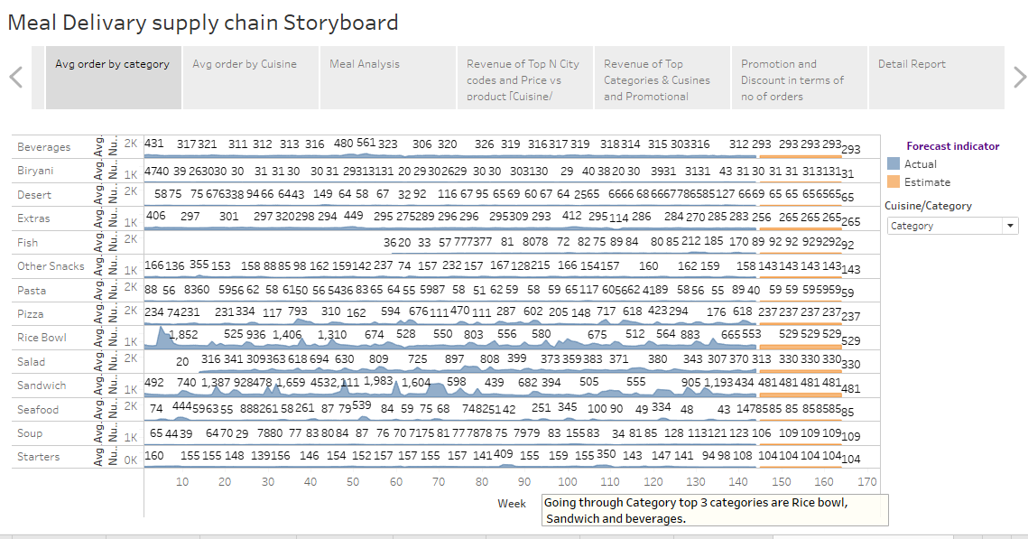

Slide 26
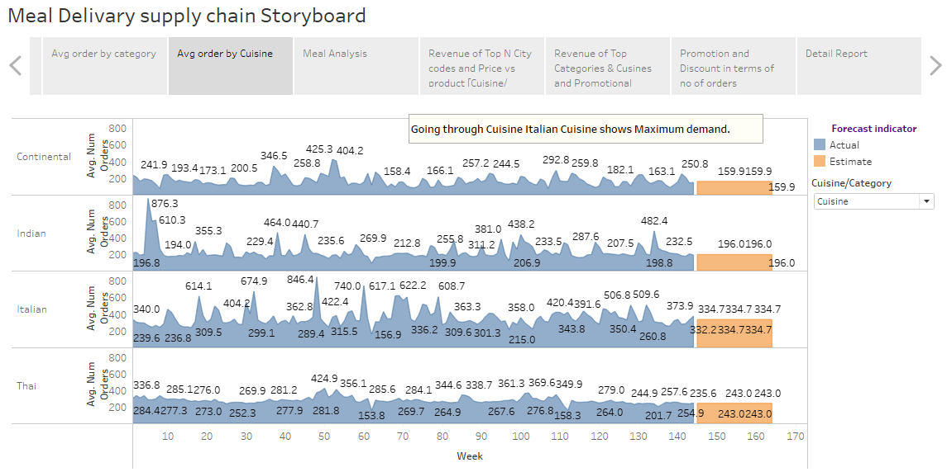

Slide 27
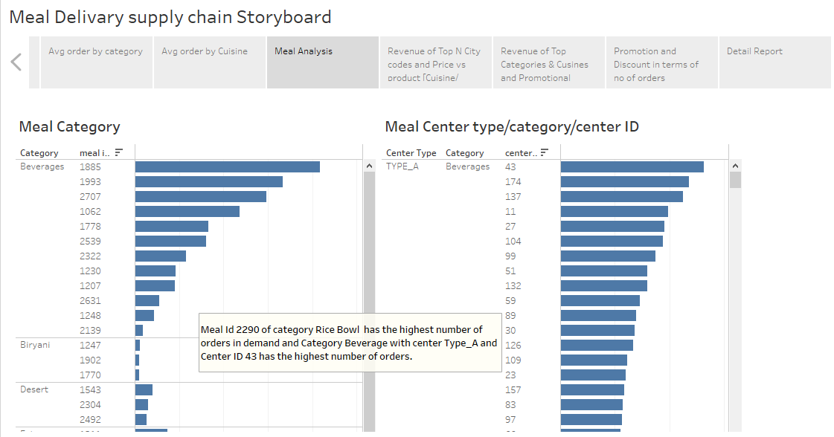

Slide 28
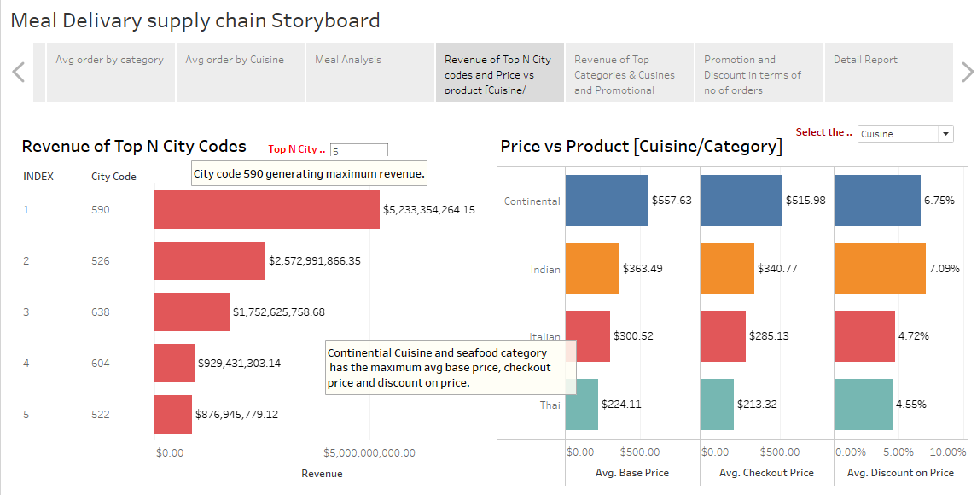

Slide 29
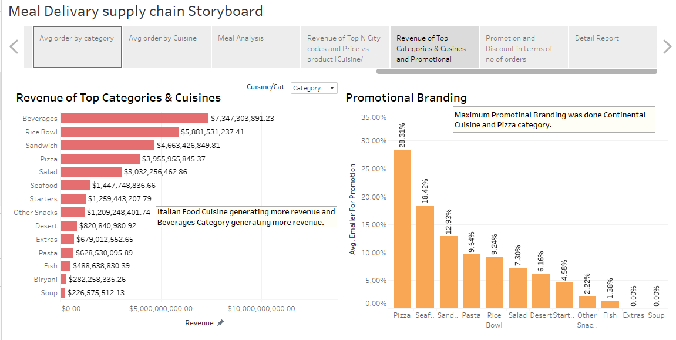

Slide 30
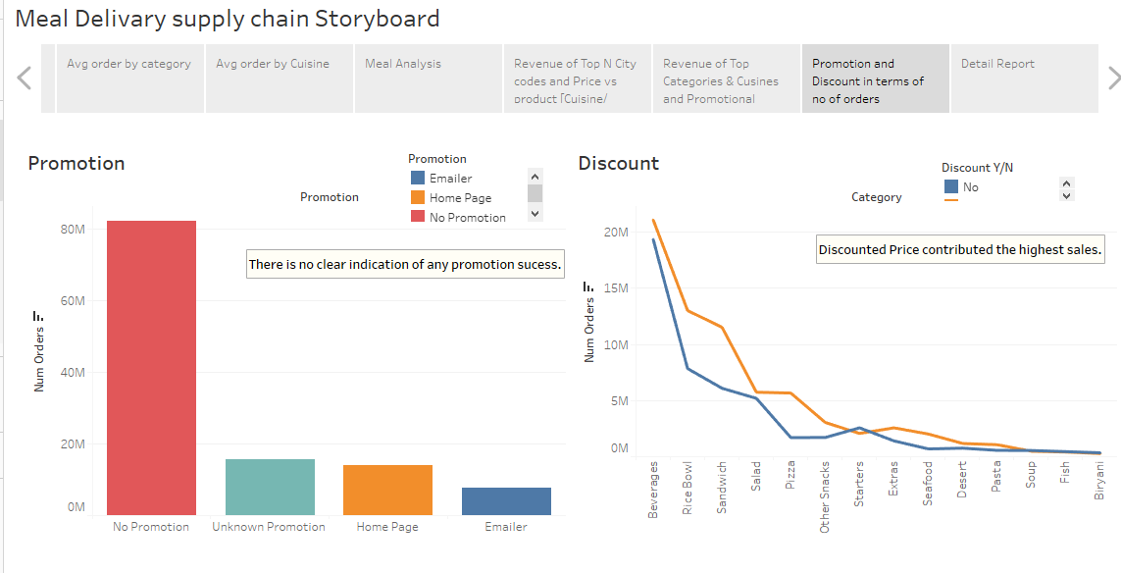

Slide 31
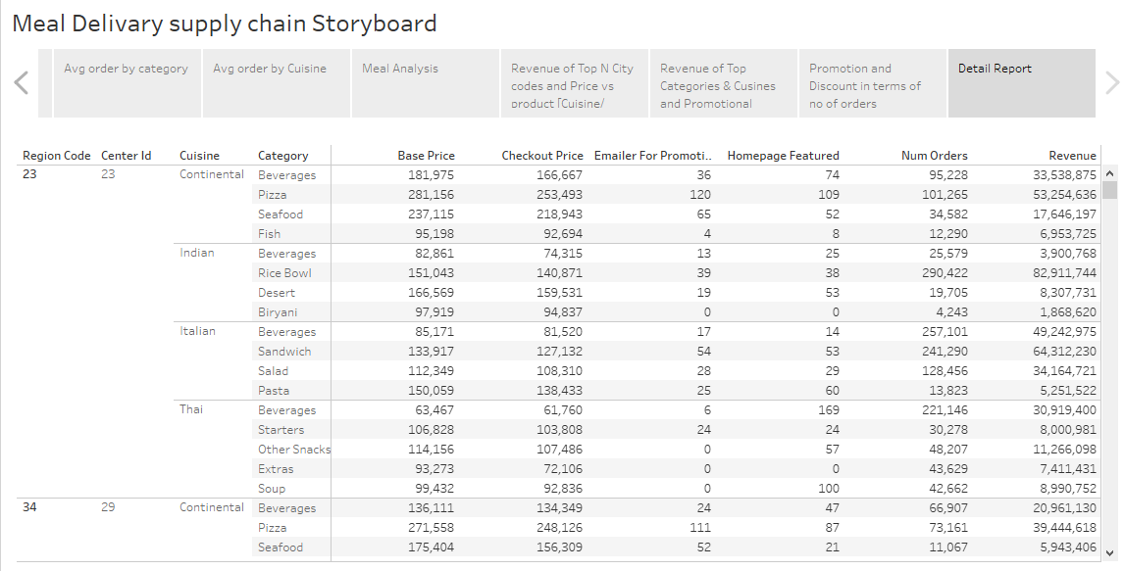

Slide 32
Conclusion
According to the Problem statement, we come up with some visualization with results. These results help to improve the meal delivery company which operates in multiple cities.
We visualize and analyze the data for each center with the product information and come up with some results which are shown above in the form of chart Visualization, Dashboards, and Storyboards and some Forecast .
So, Our client will see the end-to-end report to understand which fulfillment areas like Center Type, and City Information are doing well and which are not. Also see in the Center meal combination report and level of demand in each category, Product center combination, Product meal features such as Category, Subcategory, Current price, and discounts. This all will help to improve the performance of meal delivery company.

Slide 33
Thank you

